Slide 1



VaultScape
PLAY
Play
QUIT GAME

Slide 2
Options
Music :
Sfx :
graphics :
fullscreen
Key bindings:

Slide 3
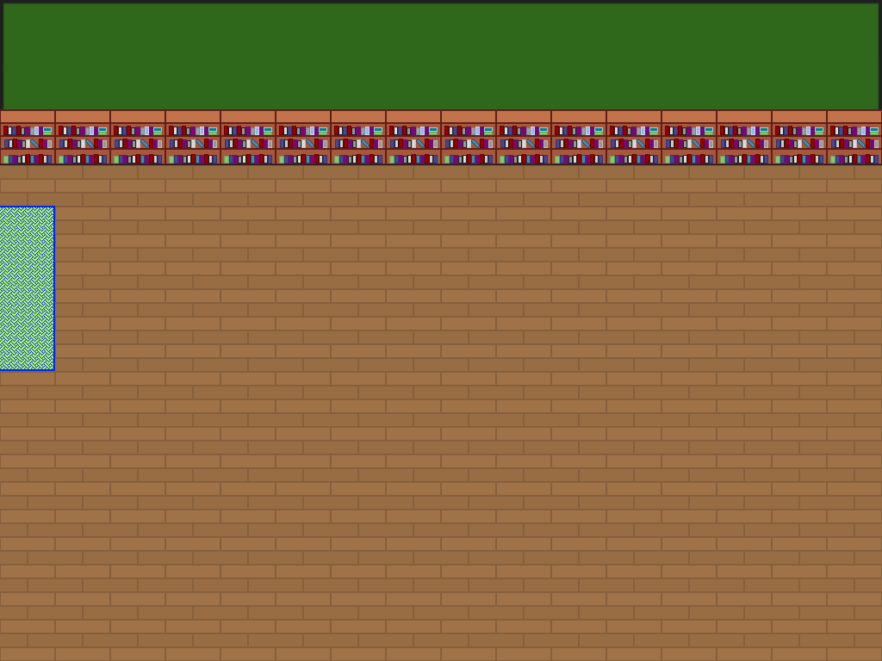


Attributes
(edgelord)
health:
10
10
Defence:
Damage:
10
Luck:
10

